Slide 1
LFTSAD: Lightweight and Fast Time-Series Anomaly Detection
RESEARCH PAPER REVIEW · IEEE TNNLS 2025
Using point-level and sequence-level reconstruction discrepancy
Lei Chen, Jiajun Tang, Ying Zou, Xuxin Liu, Xingquan Xie, Guangyang Deng · Hunan University of Science and Technology
Notes:
One-line summary: the authors built a tiny anomaly detector for factory sensor data, made of just four small neural networks, that runs on a Raspberry Pi and still matches big deep-learning models. TSAD = Time-Series Anomaly Detection: spotting abnormal readings in sensor data over time.

Slide 2
Why this paper exists
The problem
What exists
Research gaps
Factories (Industry 4.0) stream sensor data. Anomalies must be caught in real time, on small edge devices such as a Raspberry Pi 4b (2 GB RAM). Deep models (Transformers, RNNs, CNNs) are too heavy and slow.
Anomaly Transformer and DCdetector are accurate, but compute costly "association" scores. Pruning or parallelism still keeps deep models. USAD and PatchAD use MLPs but are still deep.
No shallow all-MLP detector built for edge devices
Association scoring is too expensive
Shallow nets miss subtle anomalies
Notes:
Plain-English story: sensors in a factory send data constantly. Cloud servers are powerful but add delay, so companies want detection on small devices near the machines (the edge). Existing accurate models are big. Gaps: (1) nobody had built a model from only shallow (two-layer) MLPs for this task, (2) the accurate scoring method (association discrepancy from Anomaly Transformer) is expensive, (3) small networks struggle with anomalies that are partly normal-looking (called implicit outliers).

Slide 3
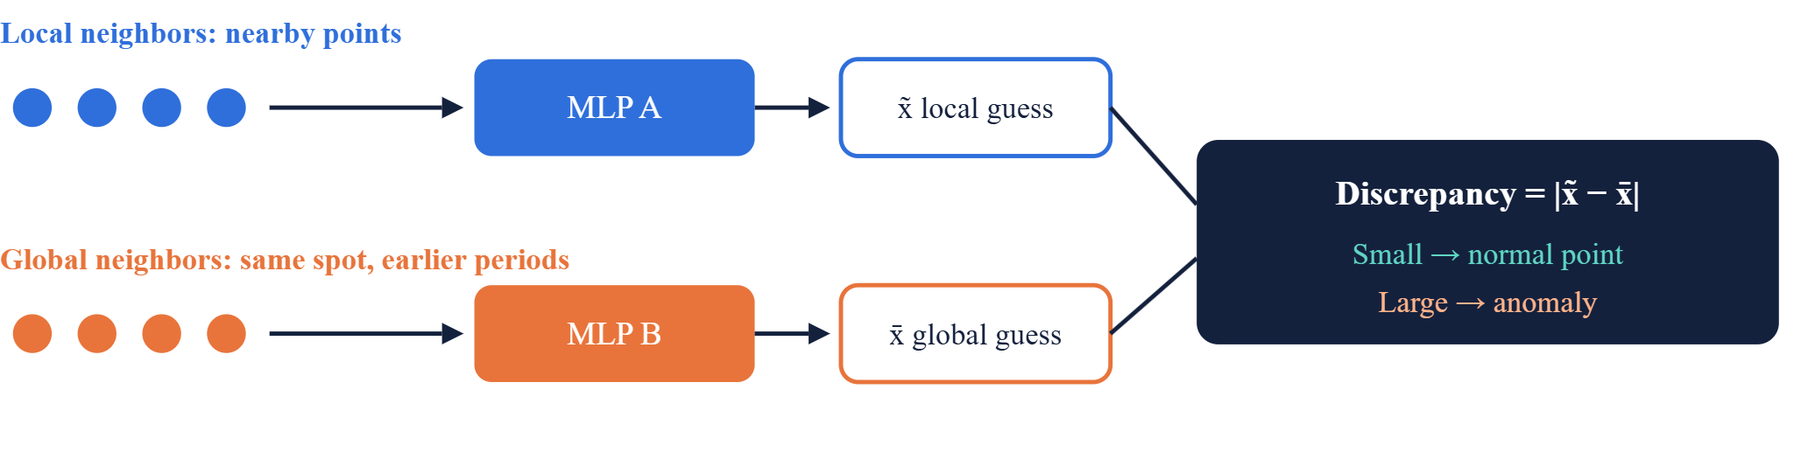
Core idea: can the neighbors predict me?
Both networks try to rebuild the same timestamp. A normal point agrees with nearby and with distant, periodic points, so both guesses match. An anomaly only fits its own odd neighbors, so the guesses disagree.
Notes:
This is the heart of the paper. Imagine guessing today's temperature from the last few hours (local) and from the same hour on previous days (global). If it is a normal day, both guesses agree. If something strange happens, the two guesses disagree. The paper replaces the costly 'association' calculation of Anomaly Transformer with this much cheaper trick: just compare two reconstructions. Training uses only normal-looking (unlabeled) data, so it is unsupervised.

Slide 4
How it works: four two-layer MLPs
Point-level branch (MLP 1 and 2)
Sensor data
MLP 1 rebuilds a point from its local neighbors. MLP 2 rebuilds it from global neighbors. Score P is their difference.
Final score
Windows of the time series. Each variable is processed in parallel.
α·Score P + (1−α)·Score S
→
→
Sequence-level branch (MLP 3 and 4)
Score ≥ threshold λ means anomaly
Same trick for short sub-sequences instead of single points. Score S is their difference.
Training: the loss (MSE) pulls the two guesses together on normal data. At test time, disagreement means anomaly. Only about 12.6K parameters.
Notes:
Walk left to right. Data goes into two branches that run in parallel. Each branch has two tiny networks with one hidden layer (two fully connected layers). The score is a weighted mix controlled by α (alpha, 0 to 1): α=1 uses only the point-level score, α=0 only the sequence-level score. If the final score is above a threshold λ (lambda), that timestamp is flagged. Complexity is roughly linear in the series length, which is why it is fast.

Slide 5
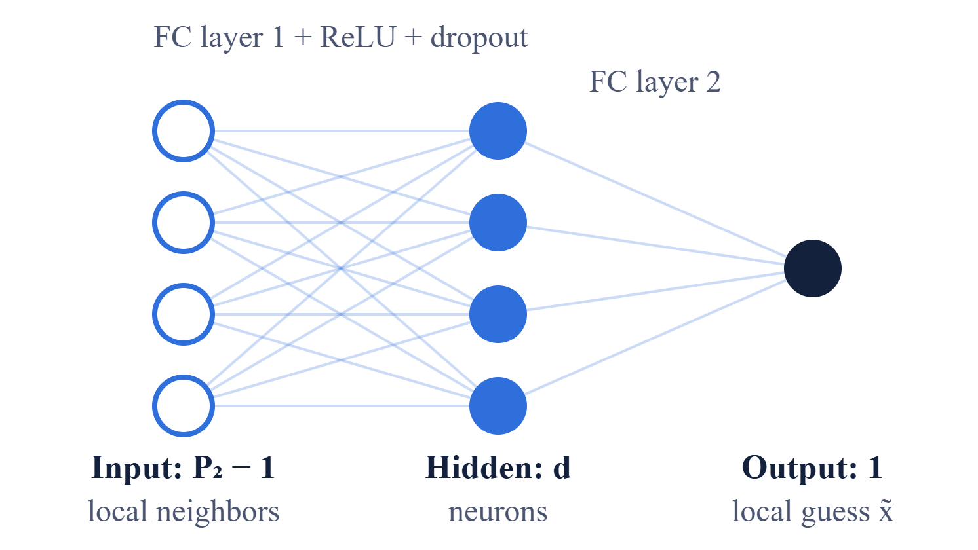
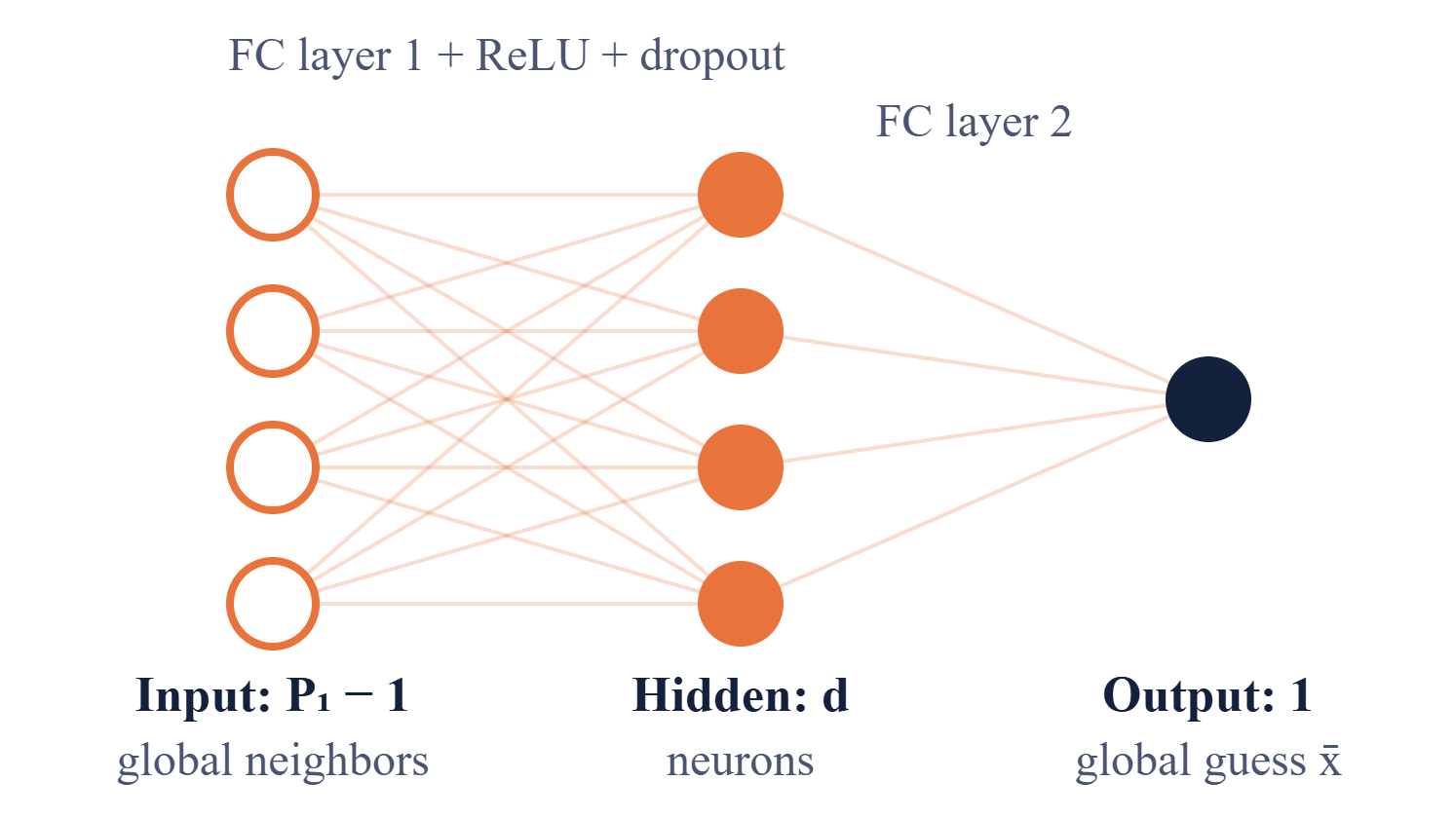
Architecture of the point-level MLPs
MLP 1: local association
MLP 2: global association
Rebuilds one timestamp from the other points in its row.
Rebuilds the same timestamp from points one period apart (its column).
Parameters: (P₂−1)×d + d×1
Parameters: (P₁−1)×d + d×1
Notes:
Each of these is a plain two-layer MLP: an input layer, one hidden layer of d neurons with ReLU and dropout, and one output neuron. P2 is the number of points per row and P1 the number of rows in the window grid (P1 x P2 = WIN). Both nets are shared across all variables, so every sensor channel uses the same two MLPs. They are trained together with an MSE loss that pushes the two guesses to agree on normal data. The difference of the outputs is Score P.

Slide 6
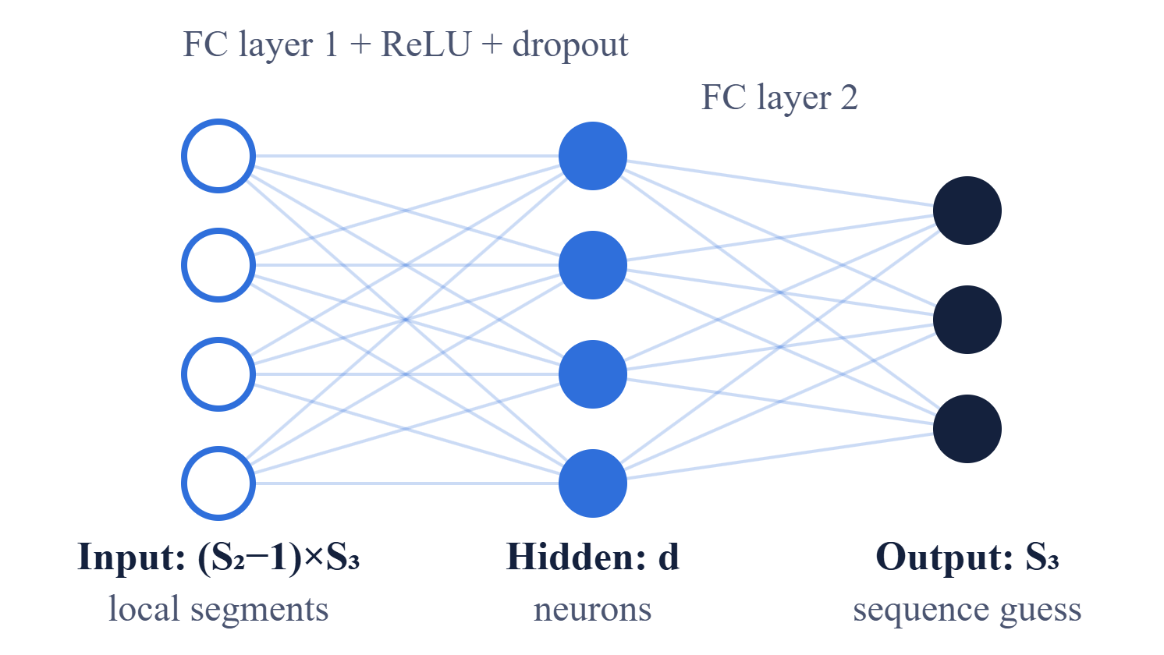
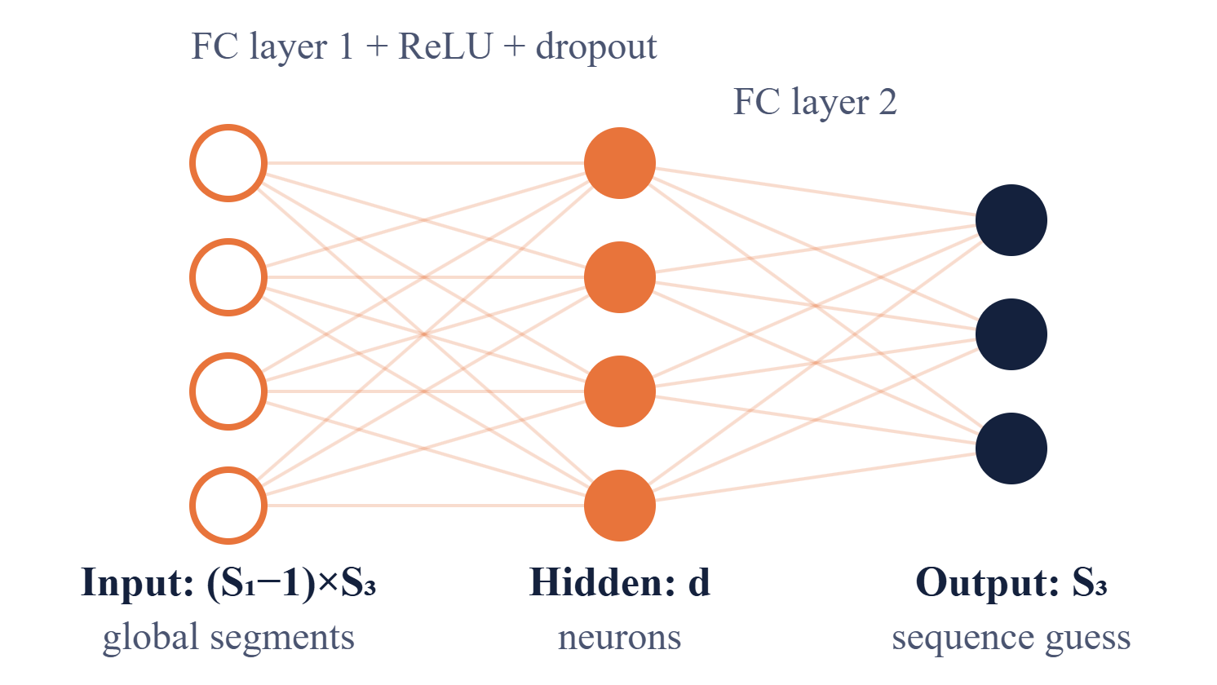
Architecture of the sequence-level MLPs
MLP 3: local association
MLP 4: global association
Rebuilds a short substitute sequence of S₃ points from the local segments in its row.
Rebuilds the same substitute sequence from segments one period apart (its column).
Parameters: (S₂−1)×S₃×d + d×S₃
Parameters: (S₁−1)×S₃×d + d×S₃
Notes:
Same recipe as the point-level pair, but the output is a short sequence of S3 values instead of a single point, so the output layer has S3 neurons (drawn here as three nodes for illustration). The window is split into S1 segments, each into S2 subsegments of S3 timestamps (S1 x S2 x S3 = WIN). Row-mates are local neighbors, column-mates are global. The difference between the two rebuilt sequences is Score S, which is blended with Score P using alpha. The paper does not list the numeric values of P1, P2, S1, S2, S3 or d in the text, so check its code on GitHub if asked.

Slide 7
Why two levels? Explicit vs implicit anomalies
Neighbor sampling
Explicit outlier
Every anomalous point clearly differs from its neighbors. Point-level learning catches these well.
Implicit outlier
Some anomalous points look normal alone. Looking at a whole sub-sequence around the point exposes them. Sequence-level learning catches these.
A window is cut into a grid. Same row (blue) = local neighbors. Same column (orange) = global neighbors. Red = the point being tested.
Together
Joint learning beat either branch alone on every ablation dataset and metric reported.
Notes:
Reasoning for having both branches: an anomaly lasts several timestamps. Some of its points are obviously odd (explicit), others look almost normal when viewed alone (implicit). Point-level catches the first, sequence-level the second. The grid on the left is how neighbors are chosen cheaply: reshape a window of length WIN into P1 x P2, then row-mates are local neighbors and column-mates are global neighbors. The paper's ablation (Table VI) shows combining both gives the best results.

Slide 8
Results: smaller, faster, comparably accurate
Training time for one epoch on a PC (seconds)
LFTSAD
26.5 s
DTAAD
148 s
DCdetector
271.8 s
12.6K
185 MB
3–10×
Top 2
parameters vs 4,741K for Anomaly Transformer
RAM on Raspberry Pi 4b vs 402 MB for DCdetector
faster than deep SOTA models (reported)
on over half of 8 metrics across 14 datasets
Notes:
Setup: 14 public datasets (8 multivariate such as MSL, SMD, SWAT, WADI; 6 univariate such as ECG, UCR), 16 baseline models, 8 metrics (Accuracy, Precision, Recall, F1 variants, Affiliation-F1, VUS-ROC, VUS-PR). Tested on a PC, a Jetson Xavier NX and a Raspberry Pi 4b. Everything except PatchAD ran on the Pi. Honest caveat from the paper: accuracy is comparable or better on many metrics, but plain pointwise F1 is weaker. Also note the paper states 12.6K parameters in Table V but '126 K' in the discussion, so use 12.6K from the table.

Slide 9
Takeaways and limitations
Takeaways
Limitations (from the paper)
Future work
Compare two reconstructions instead of computing costly associations
Four shallow MLPs are enough for edge deployment
Point plus sequence level covers explicit and implicit anomalies
Time-frequency learning, pruning, quantization
Spatiotemporal joint learning
Real-time online, federated system
Sensitive to α on some datasets
Does not model correlations between variables
No online or federated updates yet
Code: github.com/infogroup502/LFTSAD
Notes:
Closing: the contribution is a design pattern, not a bigger model. Likely faculty questions. Why unsupervised? Anomaly labels are rare. Why MLPs? Simple, fast, parallel. How is the threshold chosen? It is a preset value λ between 0 and 1. What is the evaluation weakness? Benchmarks like these are sensitive to the metric used, and the paper itself admits weaker plain F1.

